Slide 1

















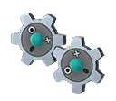
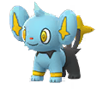
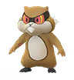










Shinx
Non Boost IV : 500
Boosted IV : 625
Drifloon
Non Boost IV : 684
Boosted IV : 855
Patrat
Non Boost IV : 452
Boosted IV : 565
0
Klink
Non Boost IV : 546
Boosted IV : 683
Weak Against
Weak Against
Weak Against
Weak Against
Writing Temple for Weather

Slide 2



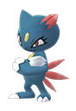
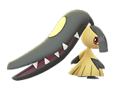
Alolan Exeggutor
Non Boost IV : 1722
Boosted IV : 2153
Sableye
Non Boost IV : 843
Boosted IV : 1054
Mawile
Non Boost IV : 934
Boosted IV : 1167
Misdreavus
Non Boost IV : 1100
Boosted IV : 1376
Sneasel
Non Boost IV : 1172
Boosted IV : 1465
Weak Against
Weak Against
Weak Against
Weak Against
Weak Against
Writing Temple for Weather

Slide 3





Machamp
Non Boost IV : 1746
Boosted IV : 2183
Granbull
Non Boost IV : 1458
Boosted IV : 1823
Alolan Raichu
Non Boost IV : 1306
Boosted IV : 1633
Gengar
Non Boost IV : 1644
Boosted IV : 2055
Piloswine
Non Boost IV : 1340
Boosted IV : 1675
Weak Against
Weak Against
Weak Against
Weak Against
Weak Against
Writing Temple for Weather

Slide 4
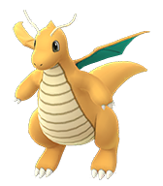
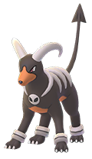
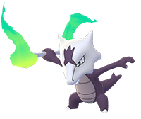

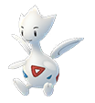
Dragonite
Non Boost IV : 2167
Boosted IV : 2709
Togetic
Non Boost IV : 976
Boosted IV : 1220
Houndoom
Non Boost IV : 1505
Boosted IV : 1882
Absol
Non Boost IV : 1443
Boosted IV : 1805
Alolan Marowak
Non Boost IV : 1048
Boosted IV : 1311
Weak Against
Weak Against
Weak Against
Weak Against
Weak Against
Writing Temple for Weather

Slide 5


Giratina ( Altered Form )
Non Boost IV : 1931
Boosted IV : 2414
Deoxys ( Speed Form )
Non Boost IV : 1645
Boosted IV : 2056
Weak Against
Weak Against
Writing Temple for Weather

Slide 6
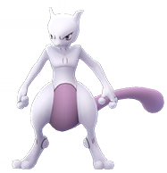
Giratina ( Altered Form )
Non Boost IV : 1931
Boosted IV : 2414
Mewtwo
Non Boost IV : 2387
Boosted IV : 2984
Weak Against
Weak Against
Writing Temple for Weather

Slide 7
?
Non Boost IV : ?
Boosted IV : ?
Weak Against
Writing Temple for Weather

Slide 8
?
Non Boost IV : ?
Boosted IV : ?
Weak Against
Writing Temple for Weather

Slide 9
Writing Temple for Weather

Slide 10







?
Non Boost IV : ?
Boosted IV : ?
?
Non Boost IV : ?
Boosted IV : ?
?
Non Boost IV : ?
Boosted IV : ?
0
?
Non Boost IV :
Boosted IV :
?
Non Boost IV :
Boosted IV :
?
Non Boost IV :
Boosted IV :
?
Non Boost IV :
Boosted IV :
?
Non Boost IV :
Boosted IV :
?
Non Boost IV :
Boosted IV :
?
Non Boost IV :
Boosted IV :
?
Non Boost IV :
Boosted IV :
?
Non Boost IV :
Boosted IV :
?
Non Boost IV : 0000
Boosted IV : 0000
?
Non Boost IV : 0000
Boosted IV : 0000
?
Non Boost IV : 0000
Boosted IV : 0000
?
Non Boost IV : 0000
Boosted IV : 0000
?
Non Boost IV : 0000
Boosted IV : 0000
?
Non Boost IV : 0000
Boosted IV : 0000
?
Non Boost IV : 0000
Boosted IV : 0000
?
Non Boost IV : 0000
Boosted IV : 0000
?
Non Boost IV : 0000
Boosted IV : 0000
?
Non Boost IV : 0000
Boosted IV : 0000
?
Non Boost IV : 0000
Boosted IV : 0000
?
Non Boost IV : 0000
Boosted IV : 0000
?
Non Boost IV : 0000
Boosted IV : 0000
Writing Temple for Weather

